Slide 1
Quarter Allotment Application
A Web App for AAI Employees

Slide 2
INTRODUCTION
An Application Form website for AAI Employees
Helps to speed up the process of Allotment
Integrates the Database System of AAI to help lessen the errors

Slide 3
GOALS
The various applications by editing stored databases
To help AAI manage and control
To ease the process of applying
For the Employees

Slide 4
CONSTRAINTS
The various rules of Quarter Allotment of AAI
Inadequate information on type of DB used by AAI
Time constraint for finishing the project

Slide 5
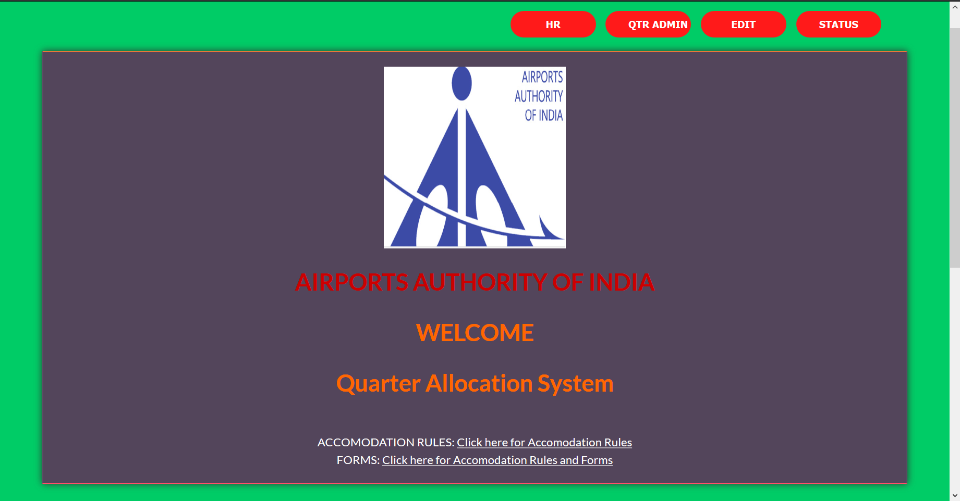
Starting Login Page

Slide 6
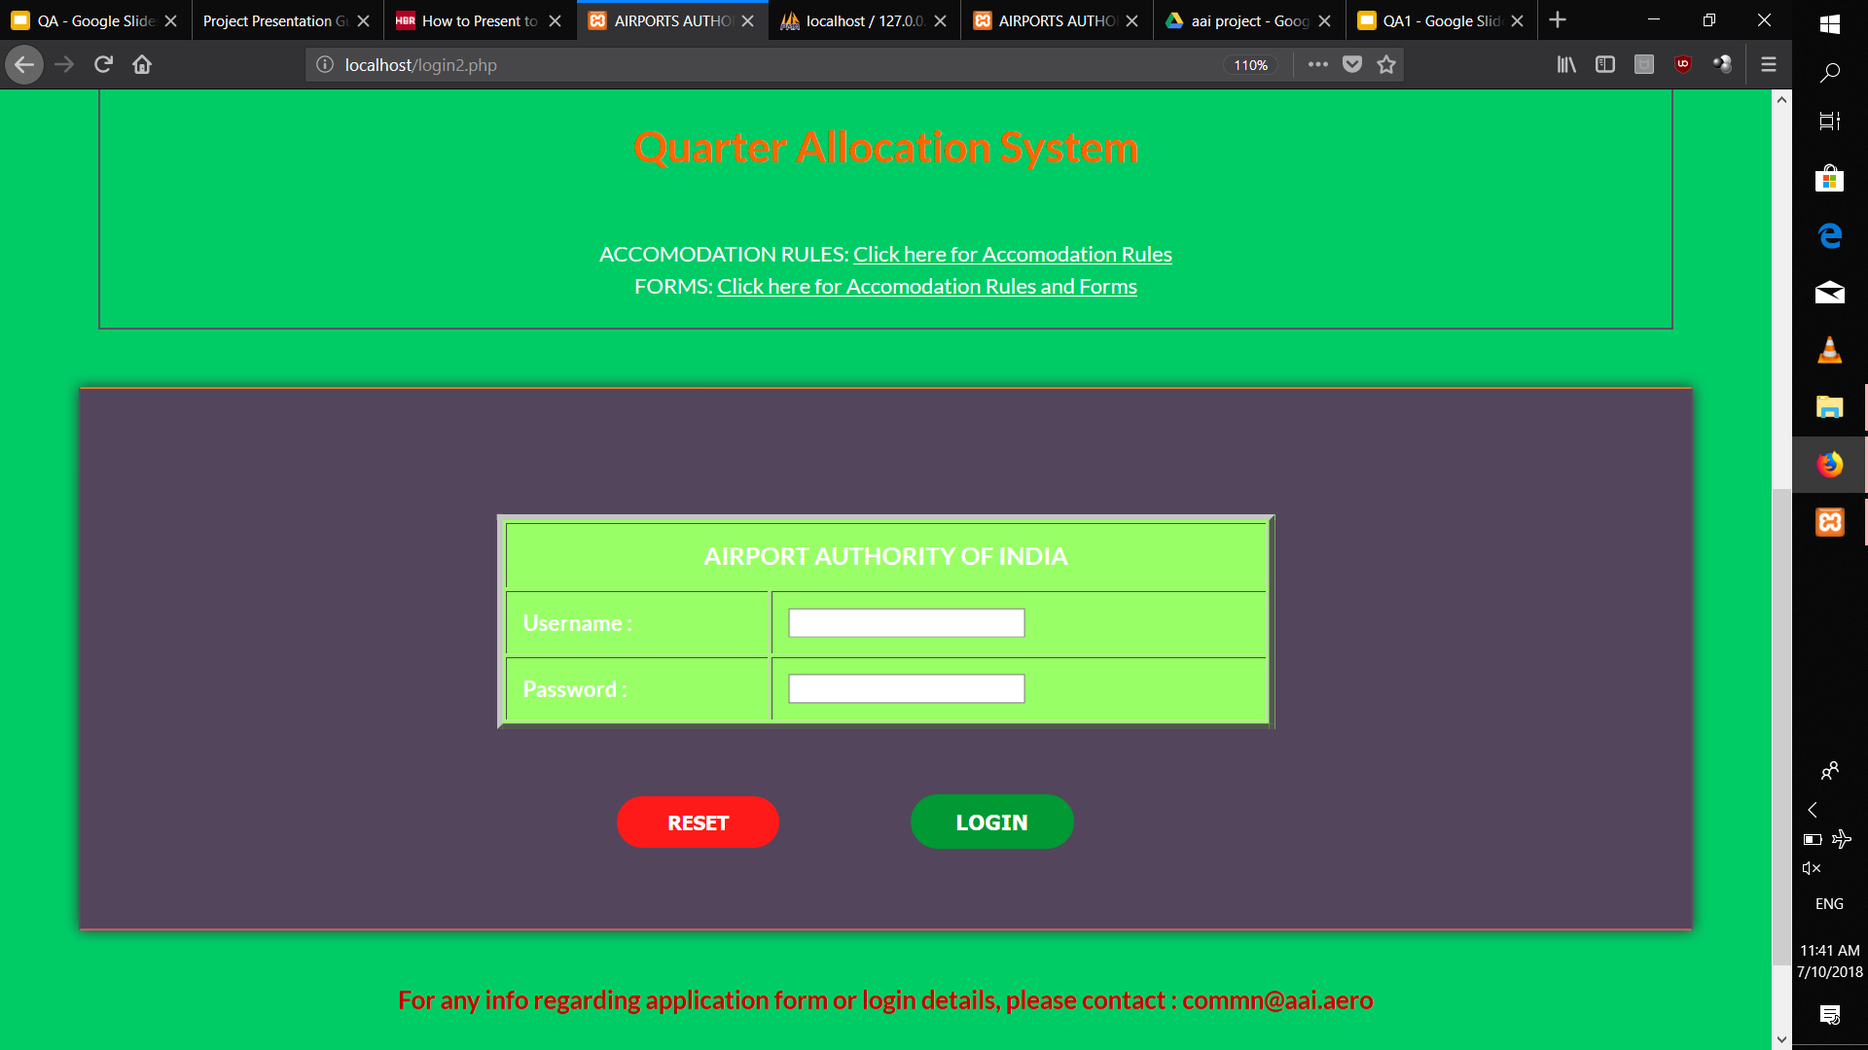
Starting Login Page

Slide 7
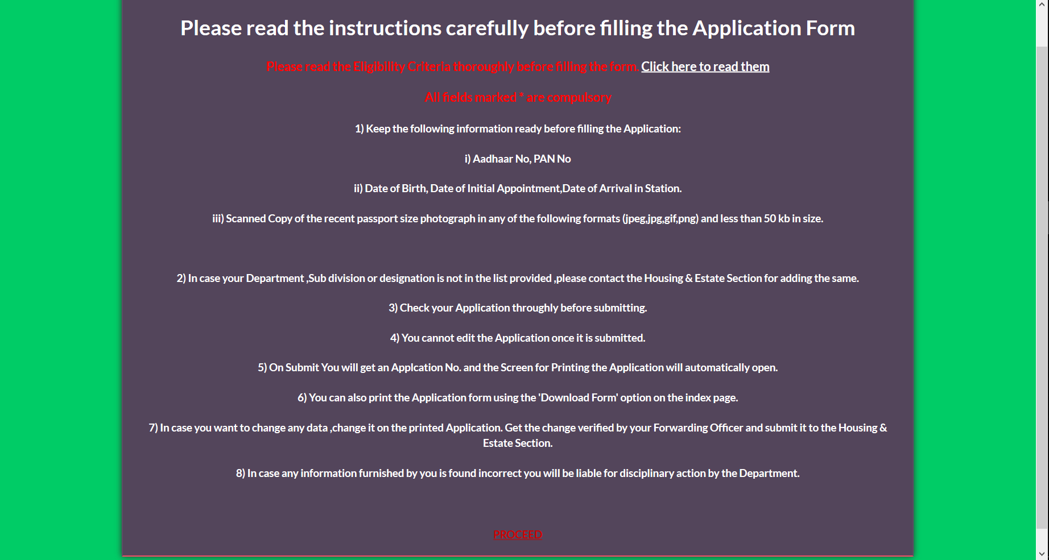
Instructions Page

Slide 8
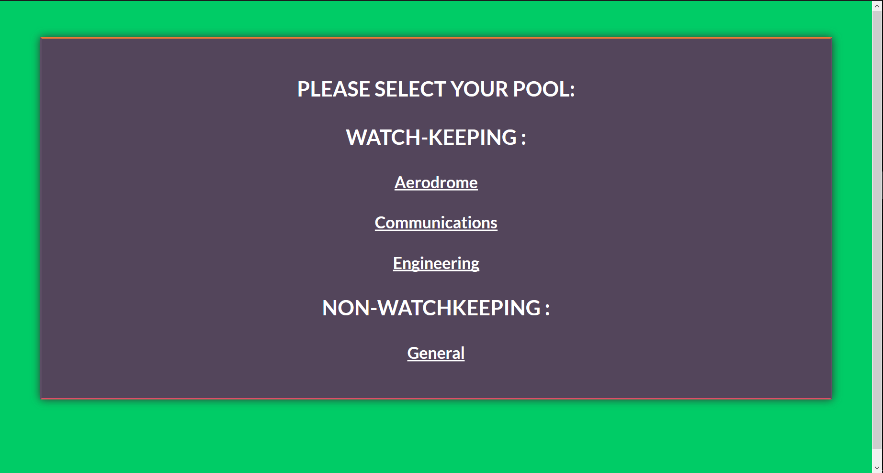
Selecting Pool

Slide 9
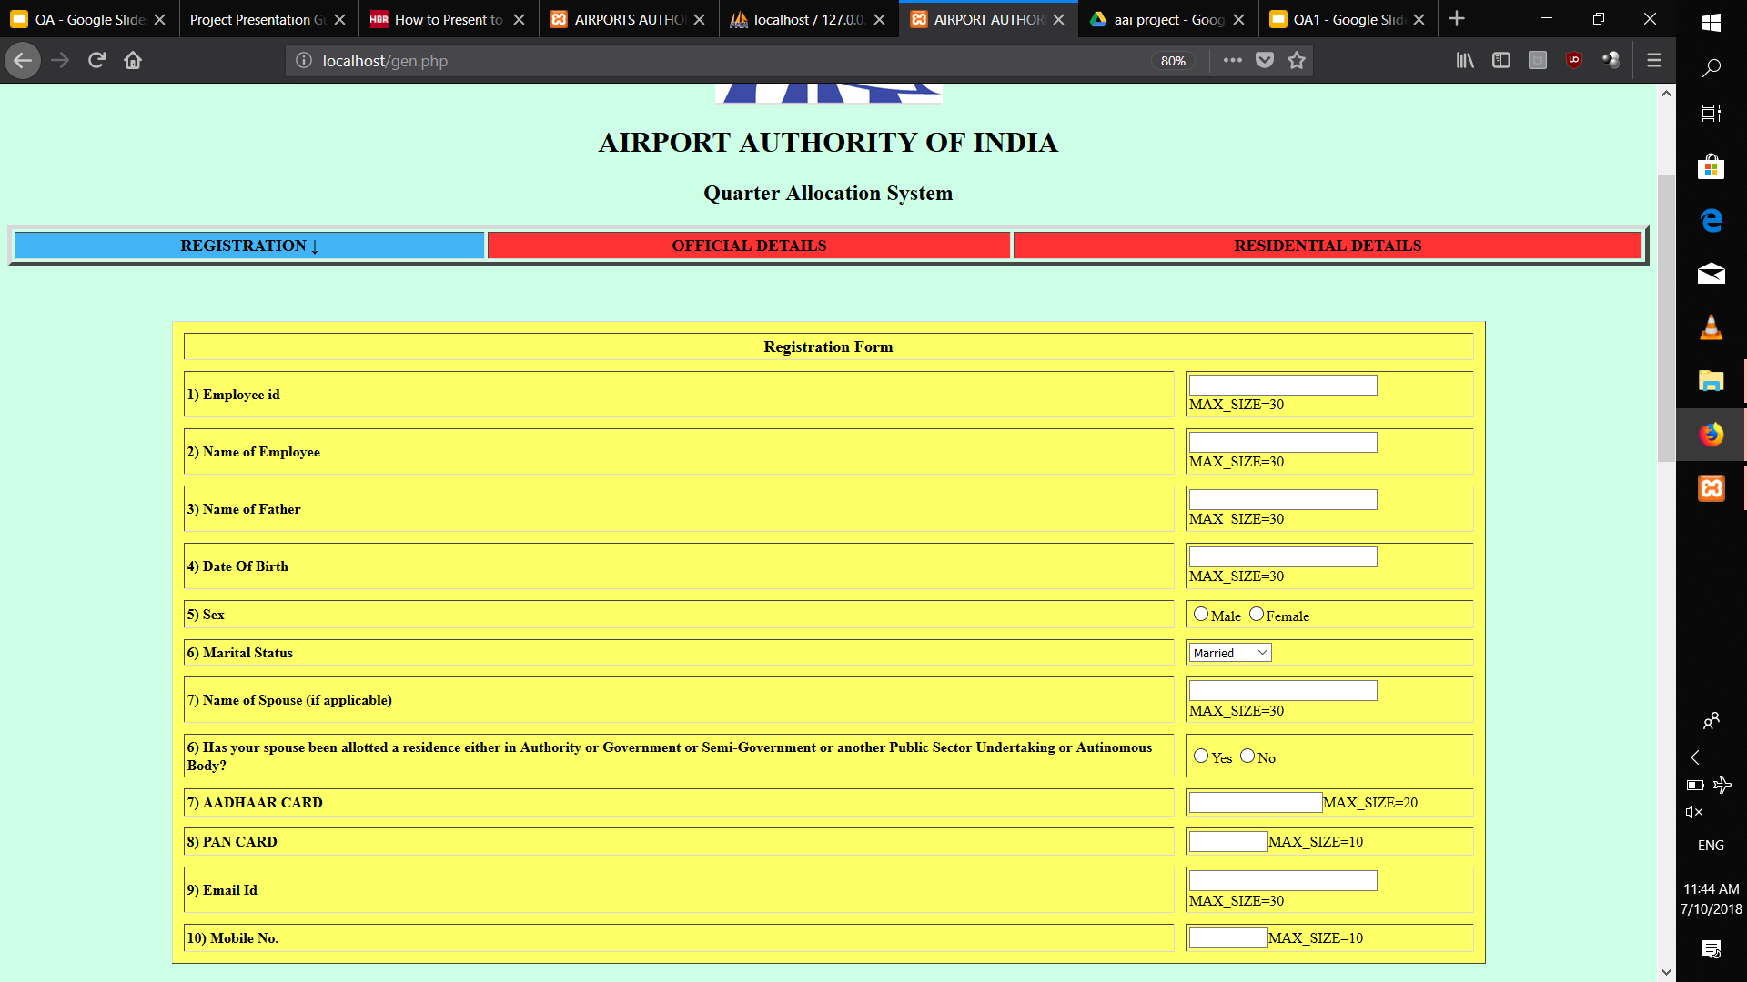
Registration Form

Slide 10
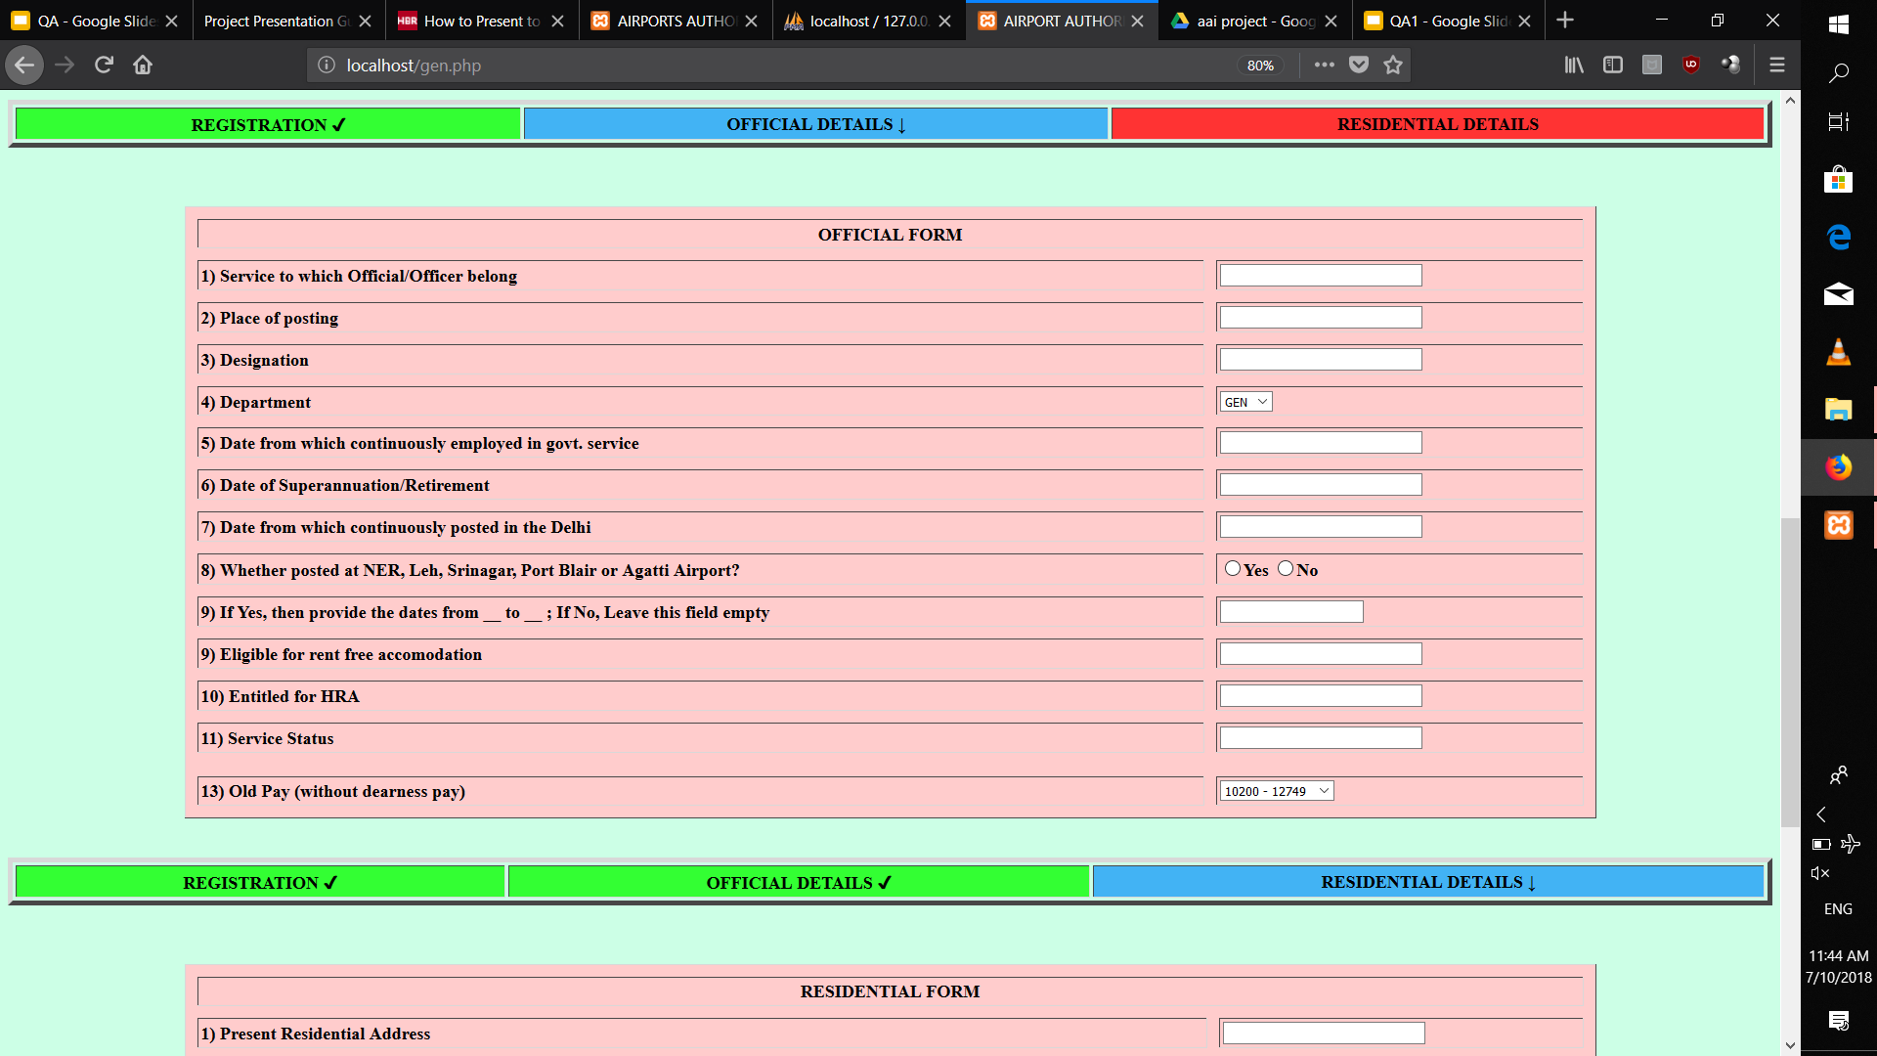
Official Details

Slide 11
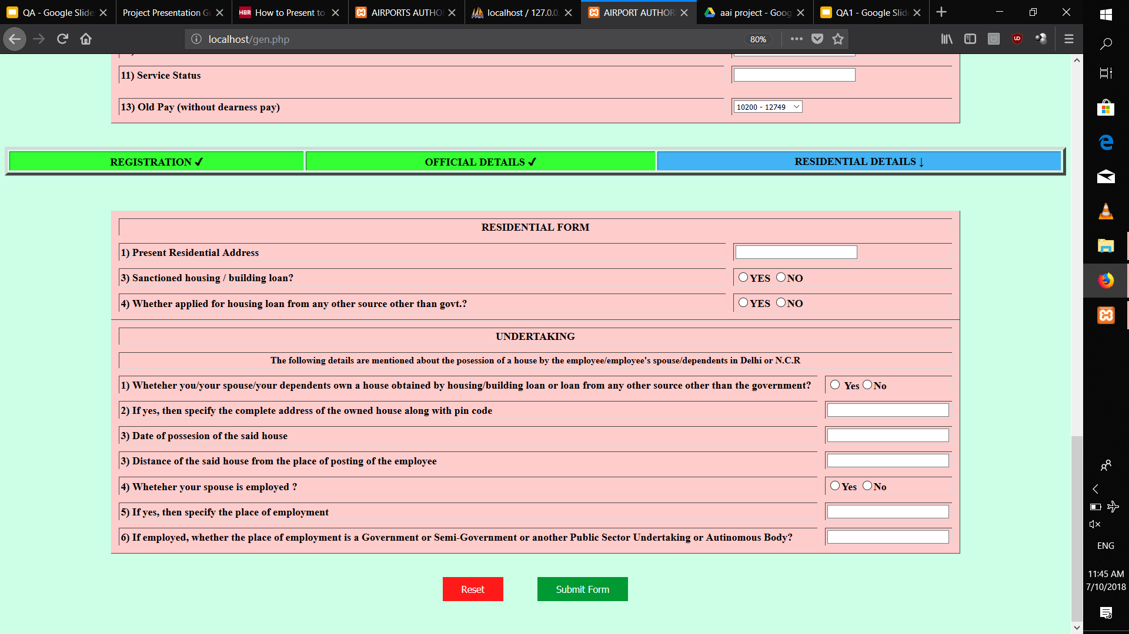
Residential Details

Slide 12
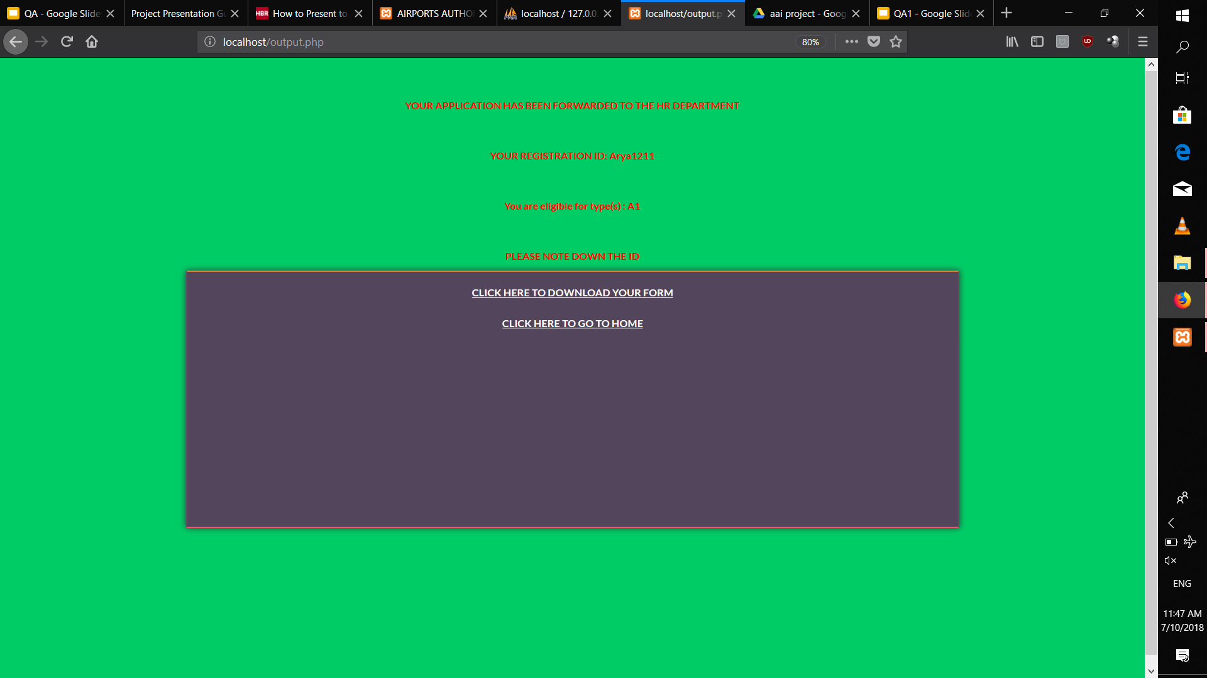
Output after filling form

Slide 13
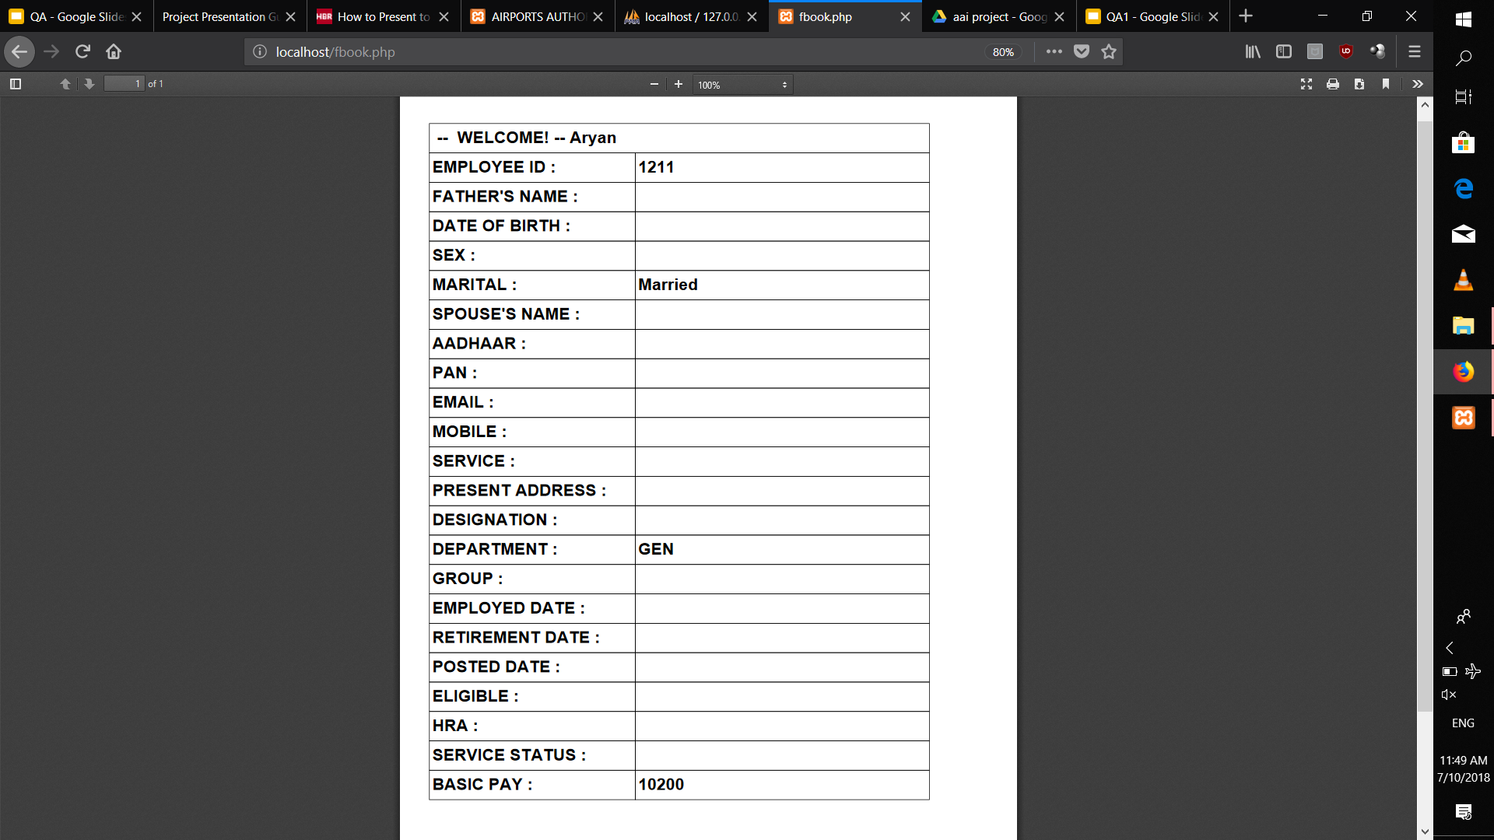
PDF form for print

Slide 14
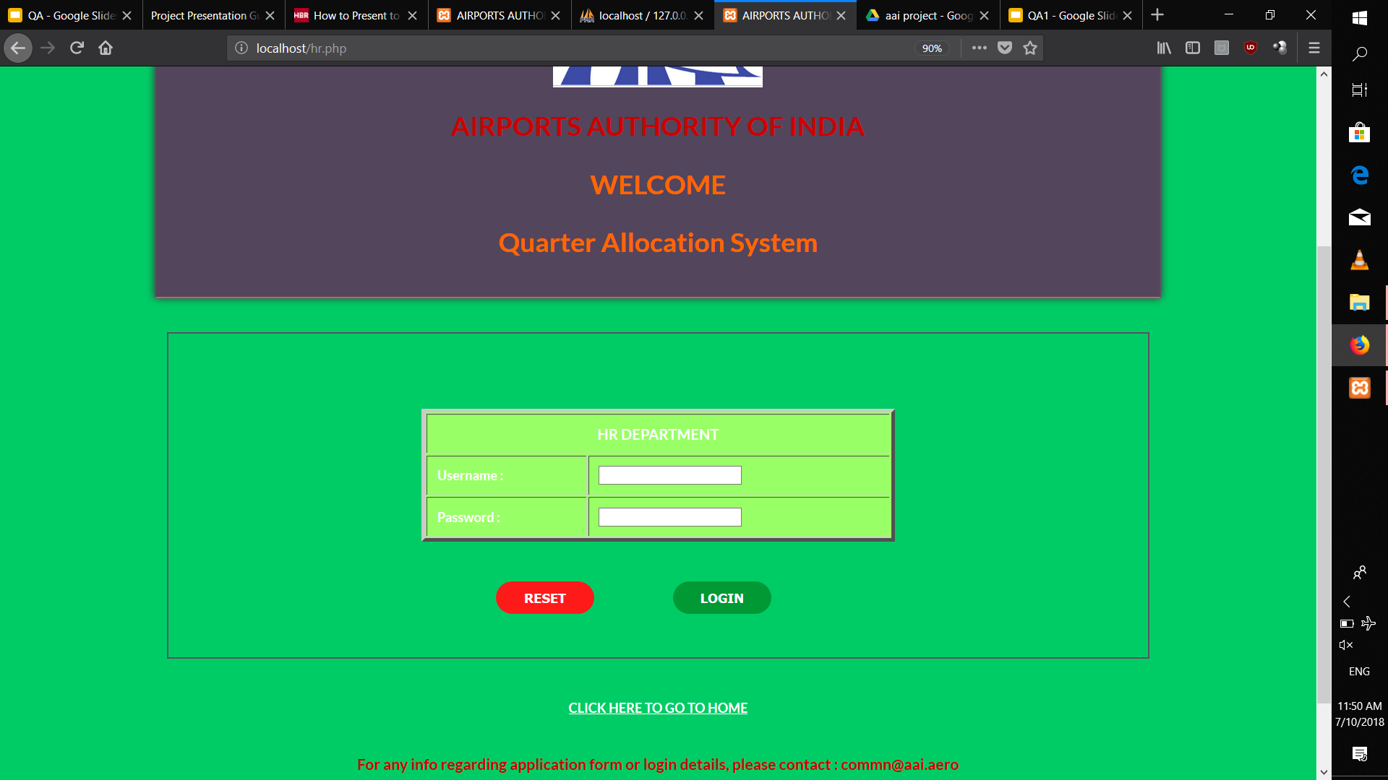
Hr Login

Slide 15
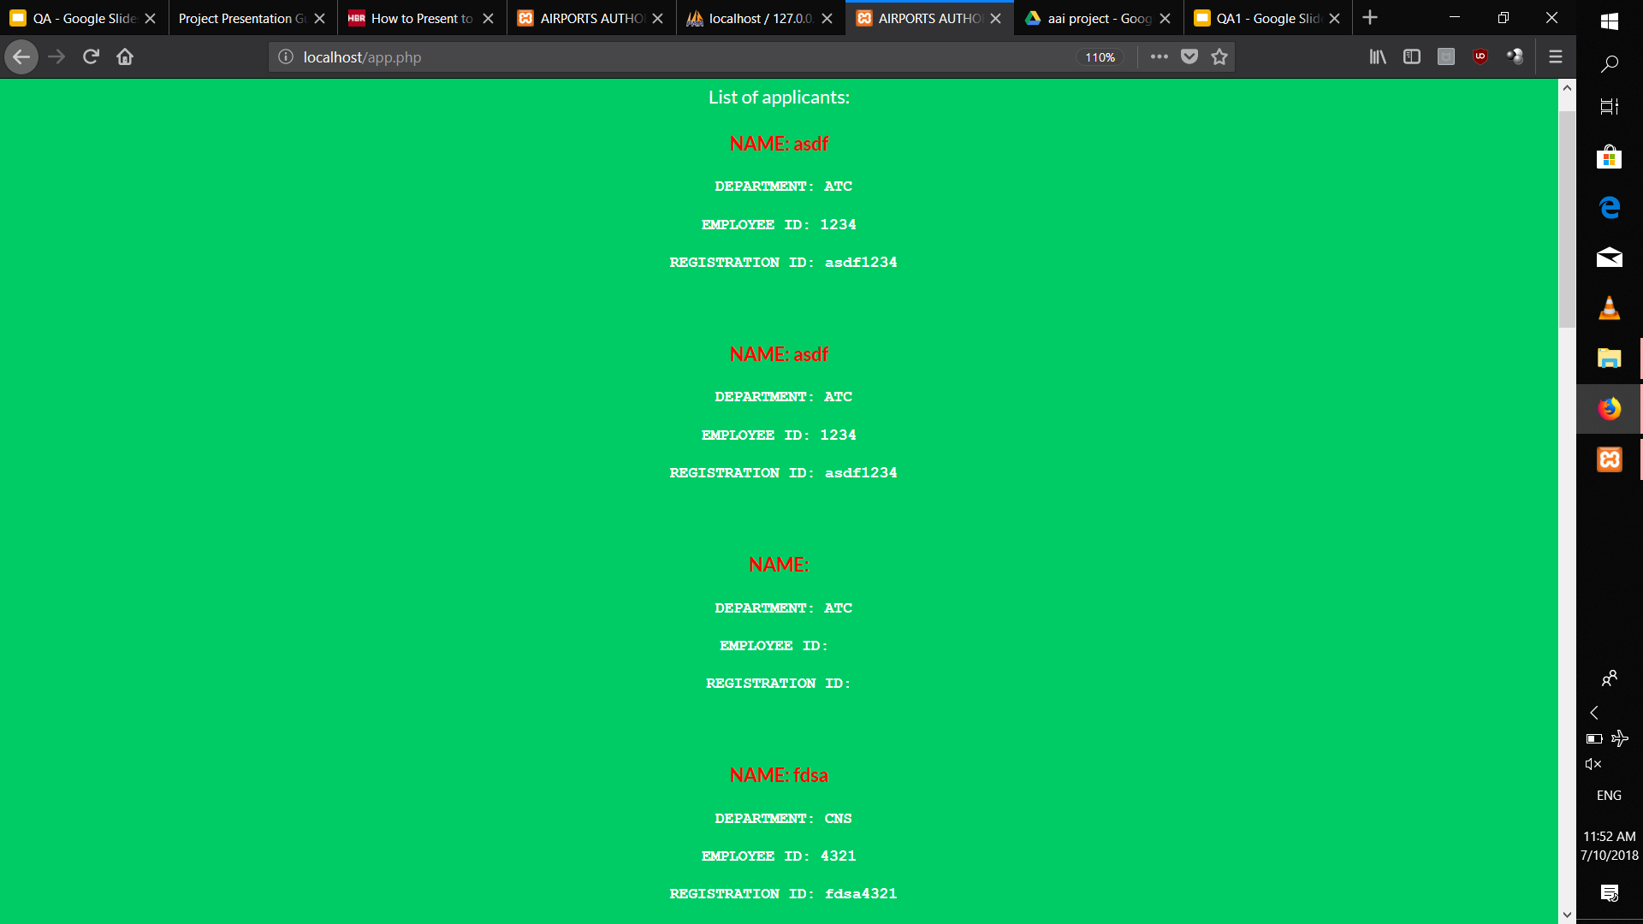
Applications for verification

Slide 16
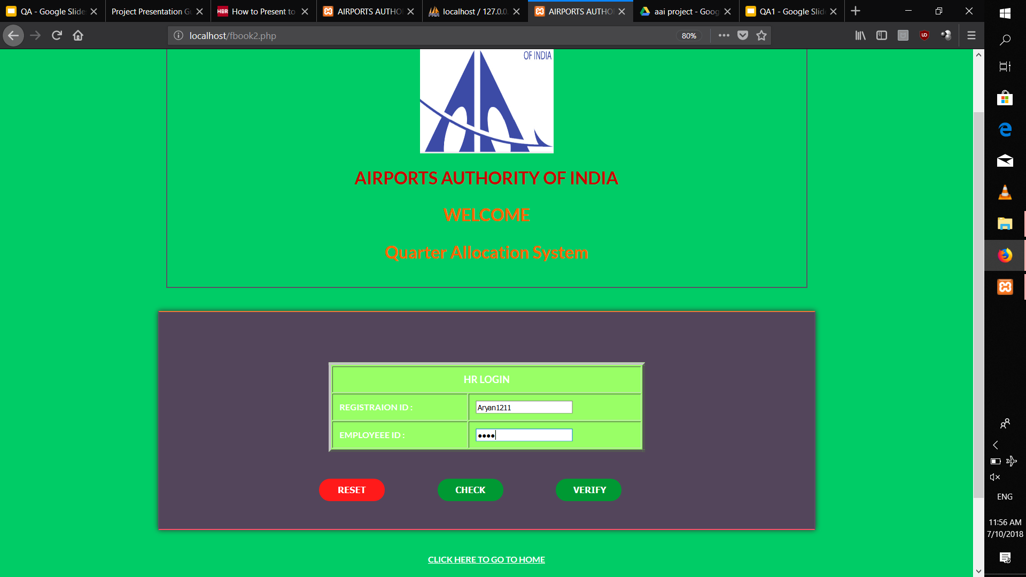

Slide 17
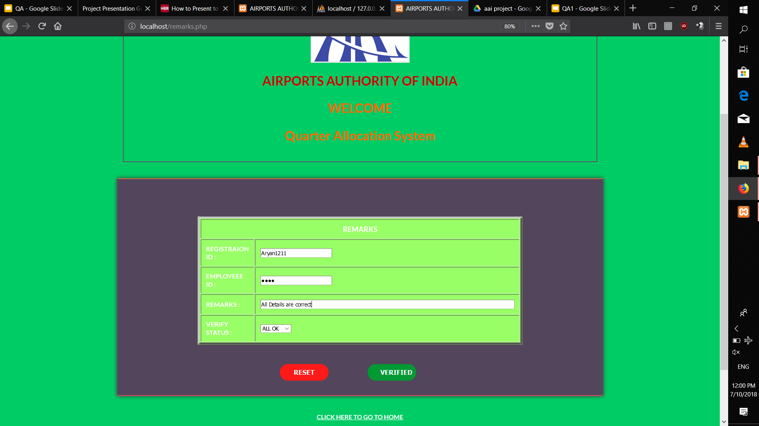
Verification remarks

Slide 18
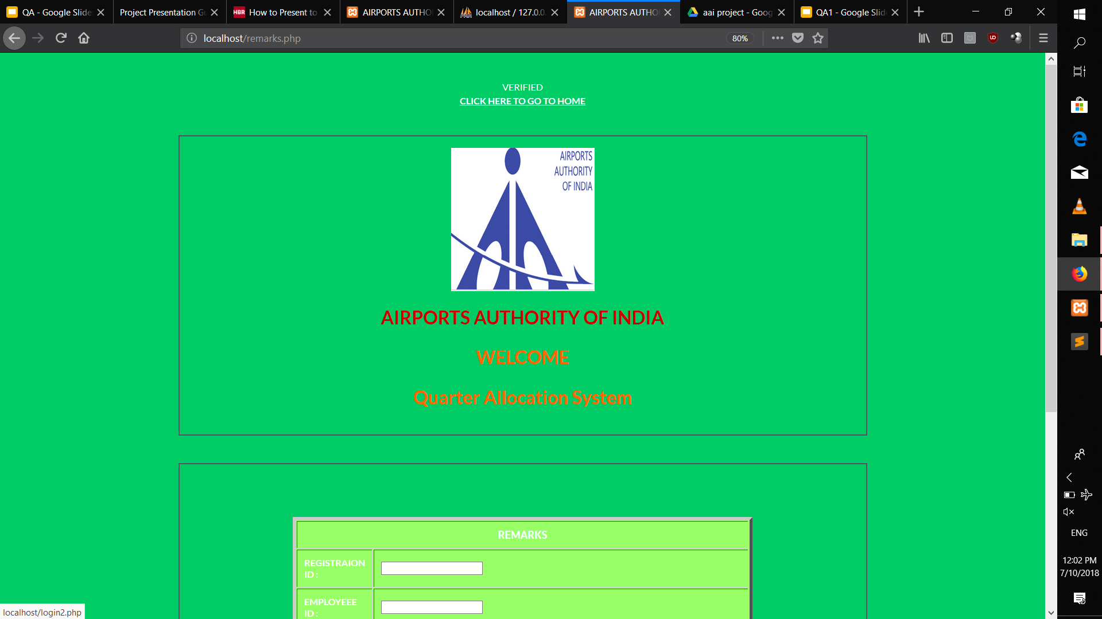

Slide 19
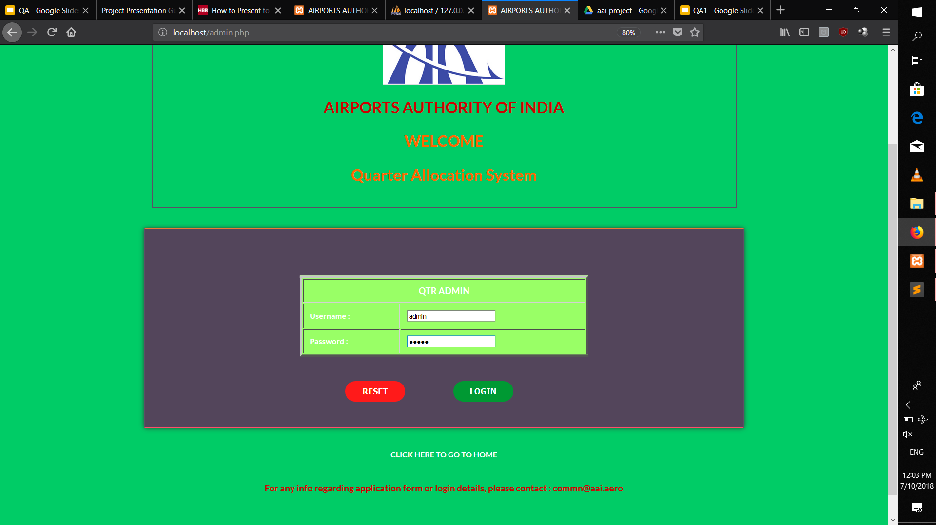
Quarter Admin login

Slide 20
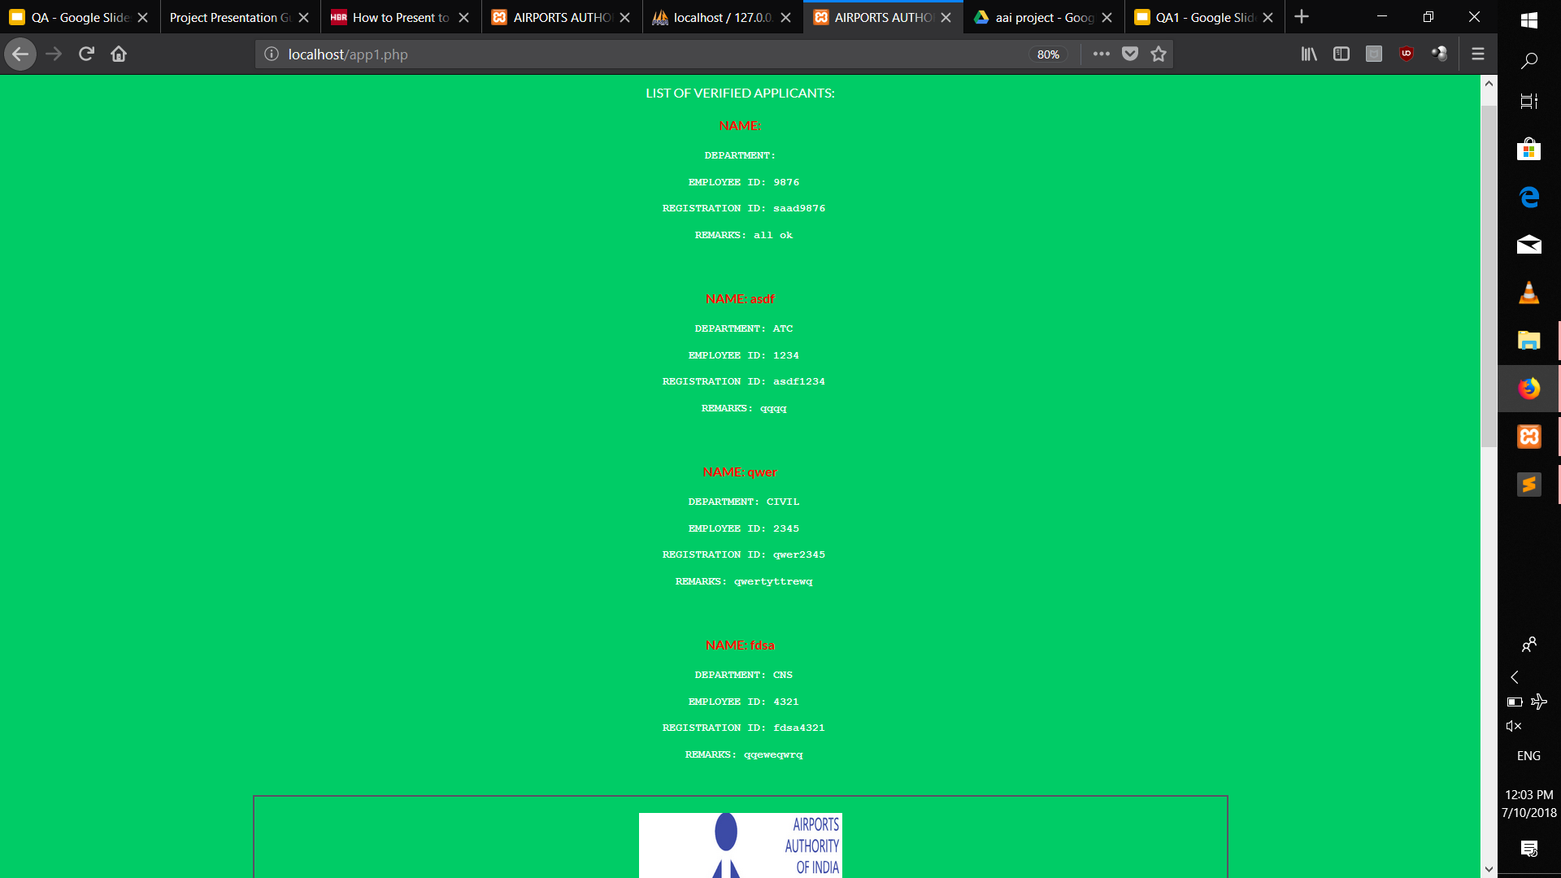
Verified Applicants

Slide 21
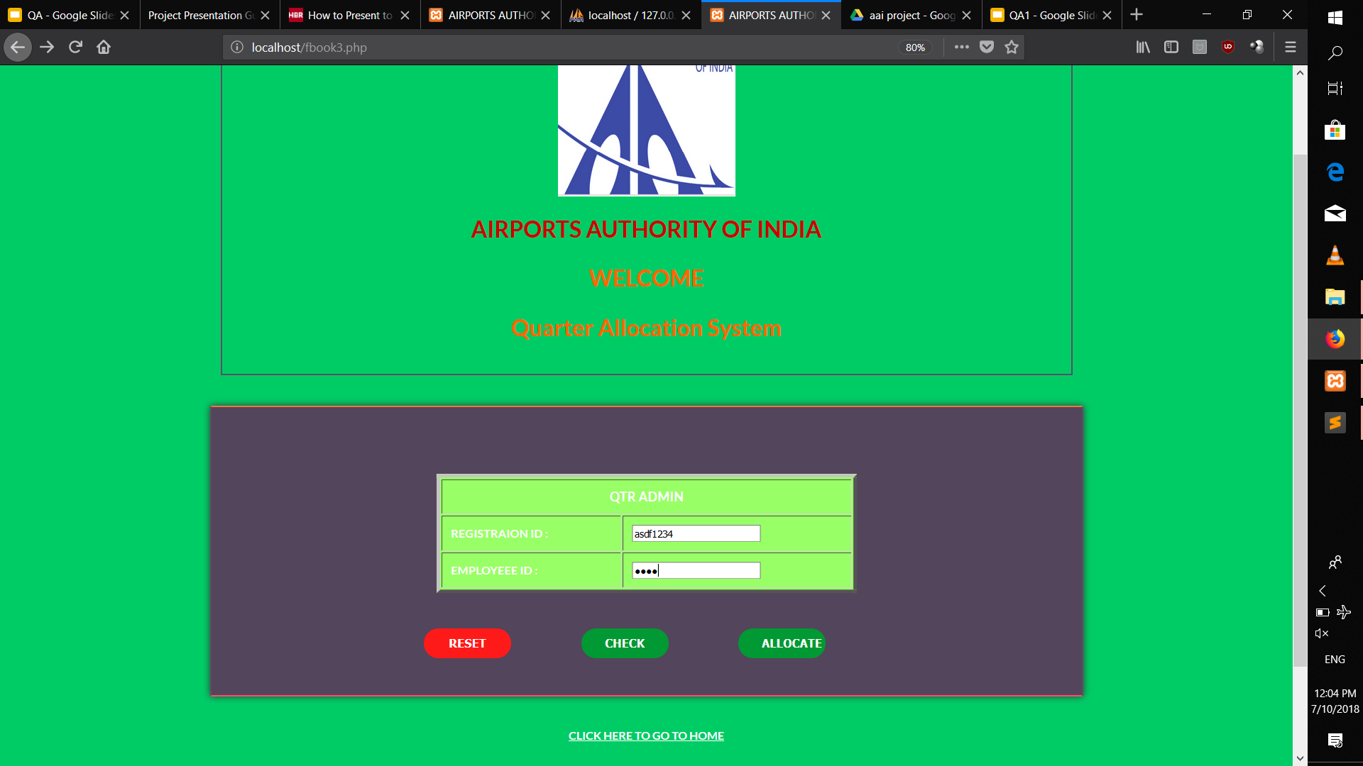

Slide 22
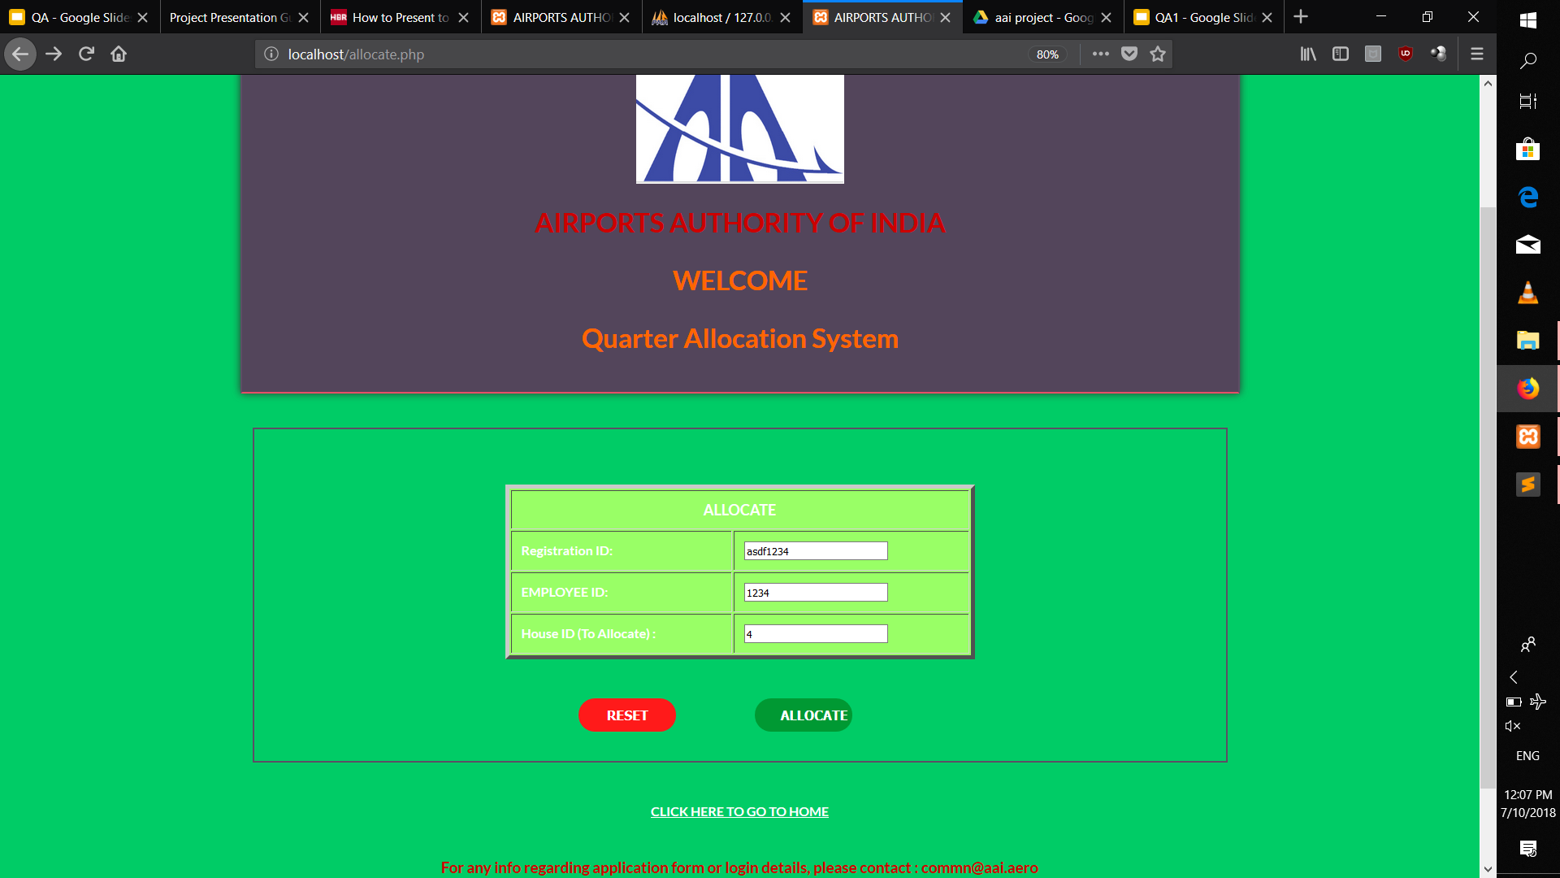
Allocating

Slide 23
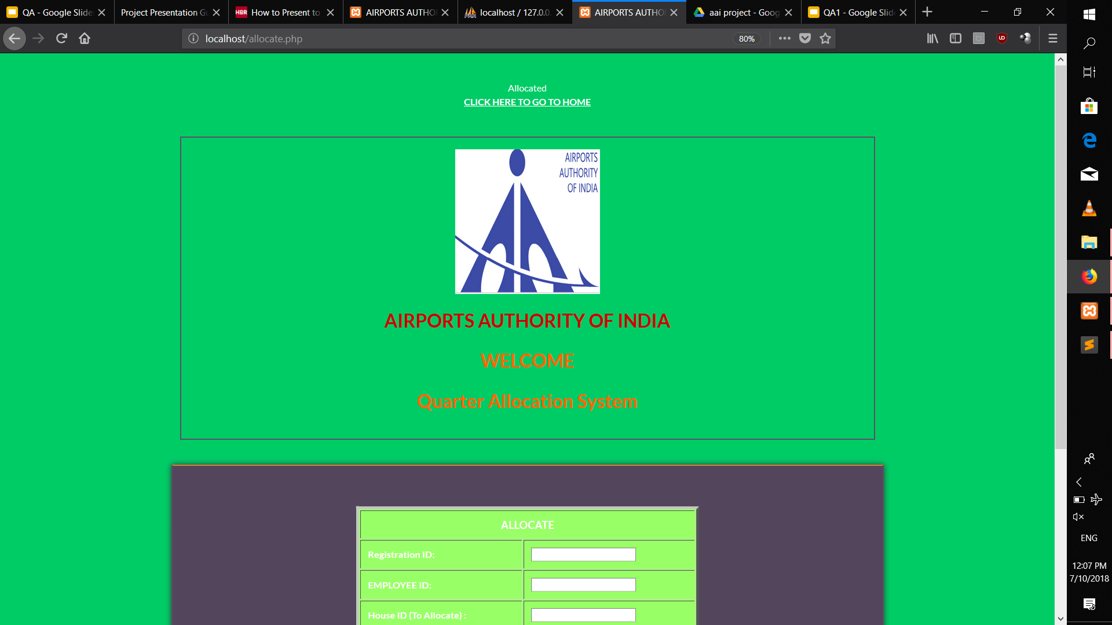

Slide 24
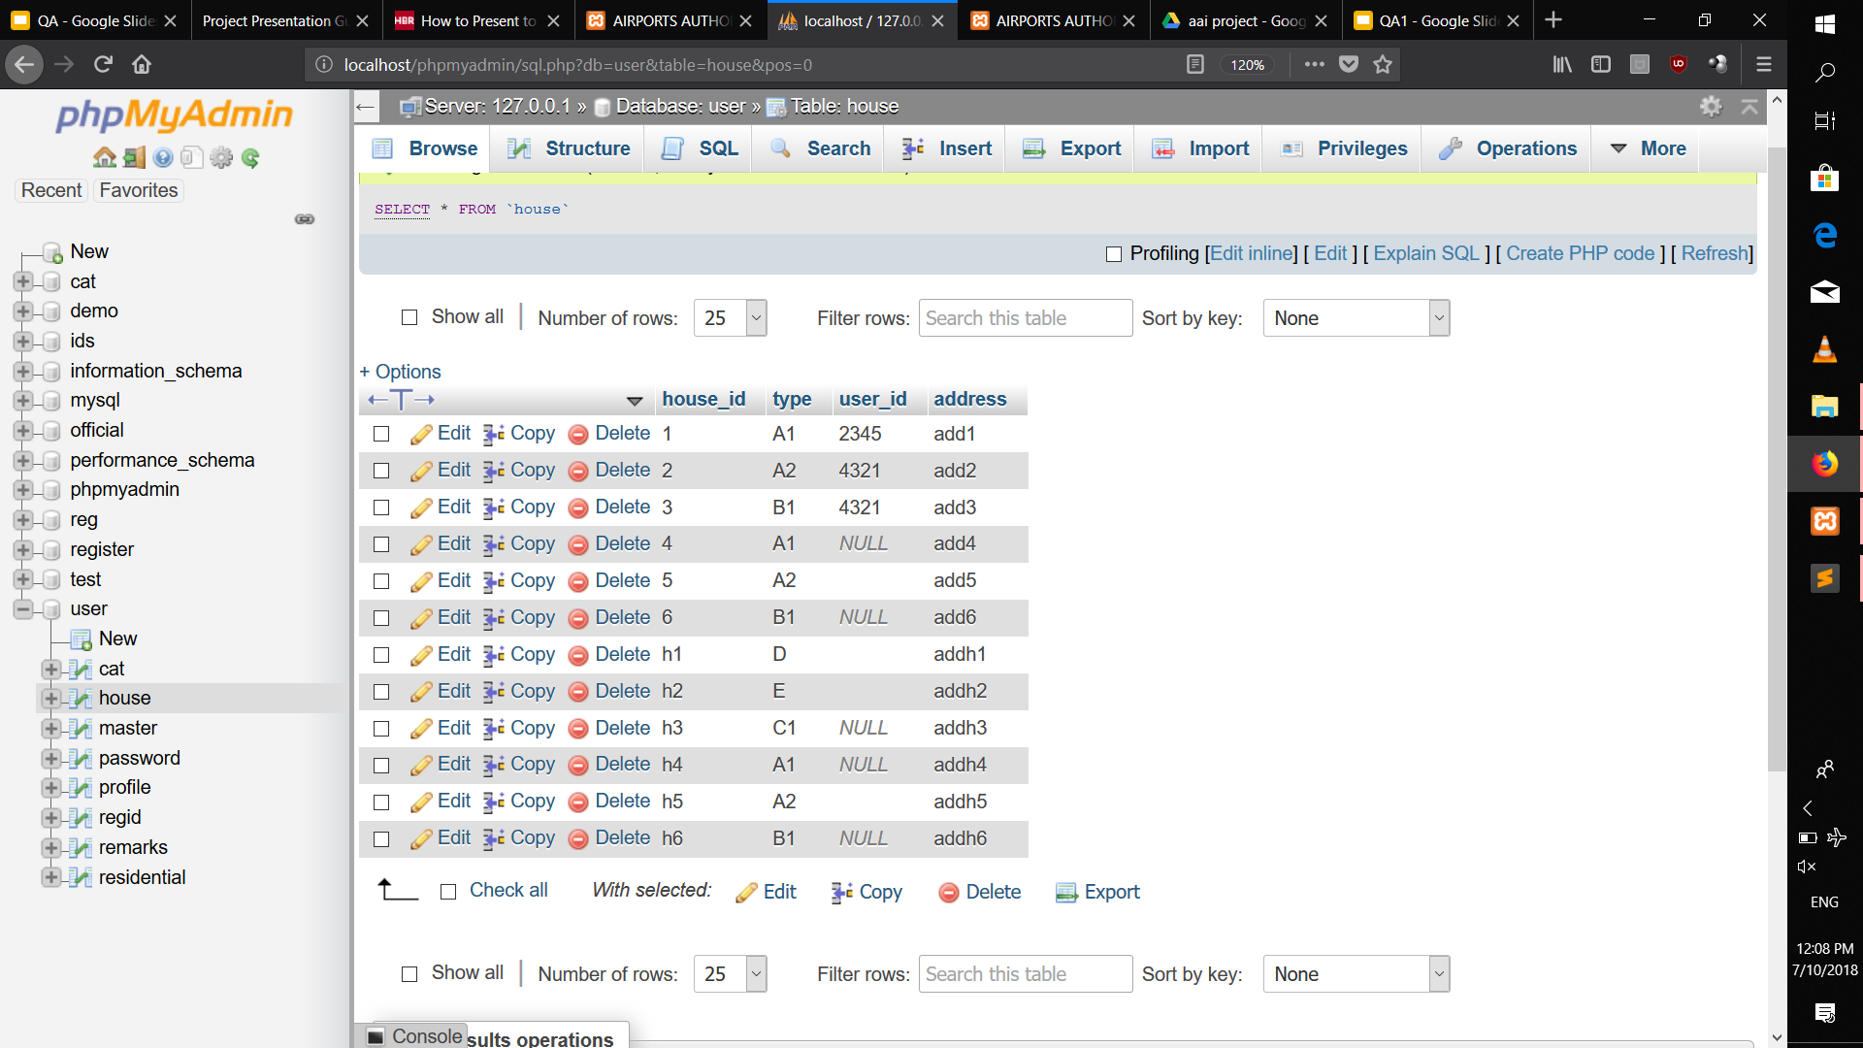
Allocation Table

Slide 25
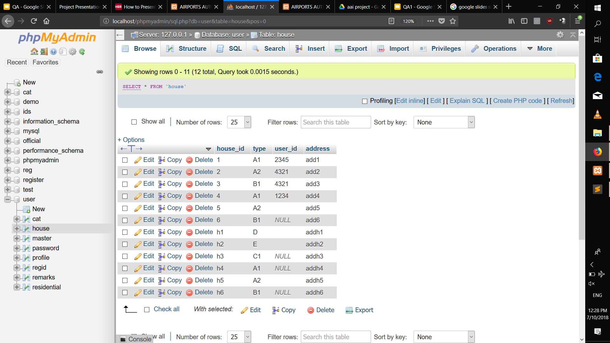
Allocation Done

Slide 26
Tools used
XAMPP - Open source server solution
Uses Apache Server
MySQL Database - administrated using ‘phpmyadmin’
Sublime Text code editor for efficient editing

Slide 27


CHALLENGES FACED
Completed
Remaining
Overall Flow and understanding Purpose of app
Functionality of the major segments
Debugging for various problems in DB management (Normalization)
Proper editing of filled forms

Slide 28
SKILLS LEARNED
Front End
Yours to client
HTML, CSS, Javascriptservice
services to you
Other departments to you
Back End
IndPHP, MySQL Database managementicate confidence level on slides if appropriate

Slide 29
SKILLS LEARNED
Using XAMPP to understand how Apache works
Managing Databases - MySQL
Various Designing prospects of HTML & CSS as well as javascript
Backend Handling with php language

Slide 30
Future targets
To organize the Database Functioning
To put Checks on various fields for efficient form fillings
To add ‘Surrender Quarter’ option for user
To make front-end more user friendly

Slide 31
Thank you!

